Slide 1
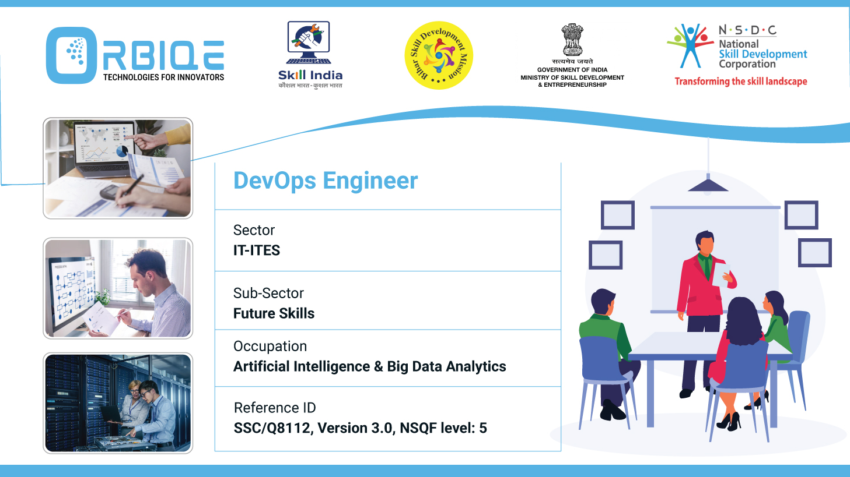
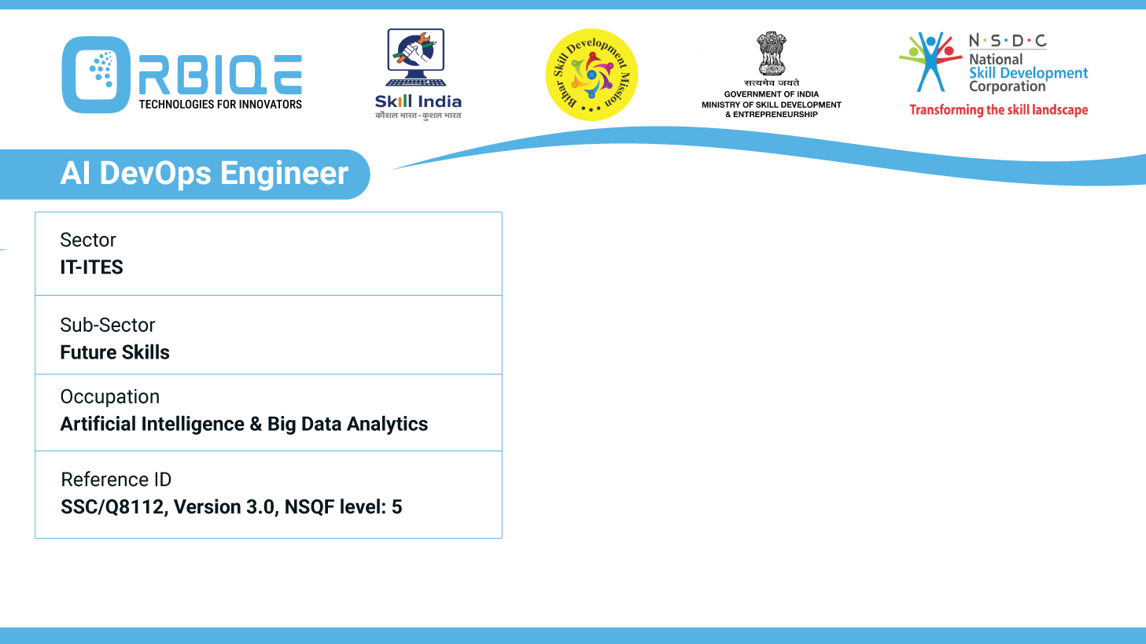
Name- Krishna Kant Dubey

Slide 2

Approaches to Designing and Developing Staging Environments

Slide 3
Agenda
Staging environments
Testing in a controlled environment
Replicating production infrastructure

Slide 4
Staging environments
Kubernetes
Chef, Puppet
Jenkins
TravisCI
Bamboo
SaltStack
Red Hat Version control software

Slide 5
Testing in a controlled environment

Slide 6
Replicating production infrastructure

Slide 7
Thank You

